Slide 1
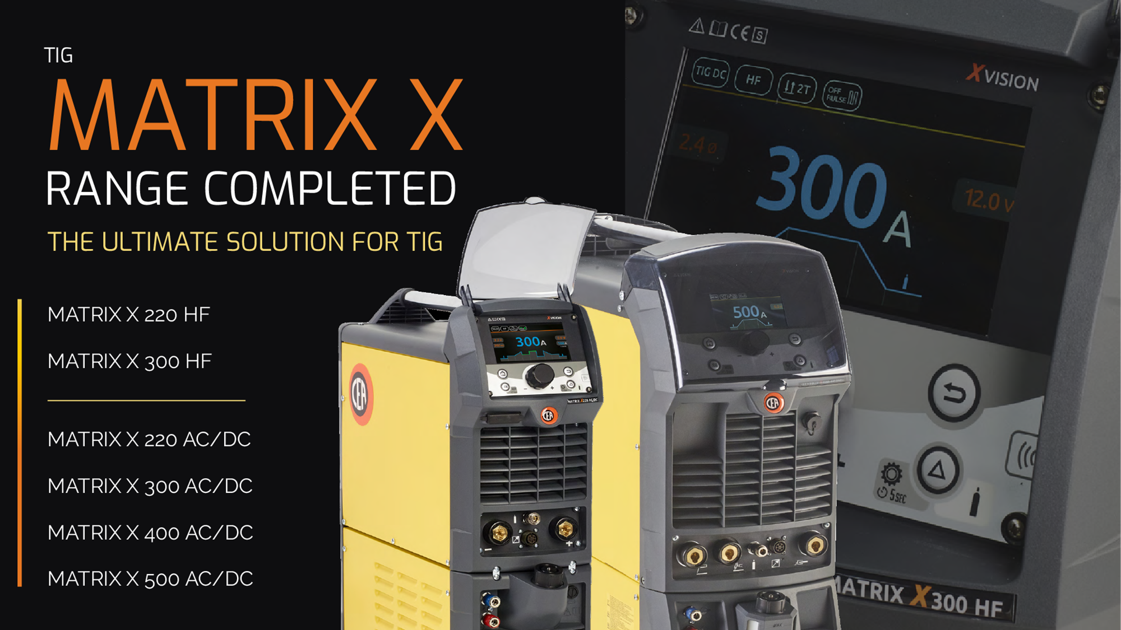
Matrix X

Slide 2
MATRIX X
Matrix X Dc 220, 300
Matrix X AcDc 220, 300, 400, 500
New XV user-interface (= X.Vision)
Also available -- with conventional operation-panel
u/d torches (parameters + jobs)
Very stable/reliable ignition
DC – 1A min.current
AC – 3A min.current
Perfect-Point … best-possible Spot-Position
Repeated-Ignition Function
Ignition - always on positive wave (AC)

Slide 3
RCT … Running Cold Tack
COLD TACK => RCT Running Cold Tack - on DC
For thin sheets
Minimal thermal input – compared to (puls) TIG
Default-Setting
Amperage => max.
Tack-Time
Pause-Time => 1 sec (to avoid malfunction of automatic helmets)
Quan. of Impulses => 1 (max. 10)

Slide 4
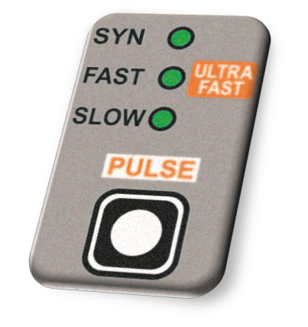
PULS-modes
SYN (Easy-Puls)
Synergic Puls - based on set peak current.
Simple
DC
SLOW
Peak / base current + time - individually adjustable
Optimal filler-deposition => good look
Useful – in combination with BALANCE / Frequency
AC / DC
FAST
0,5 - 500 Hz for more concentrated arc cone!
Smaller arc-diameter
Less deformation
DC
ULTRA-FAST
Up to 2000 Hz
DC

Slide 5
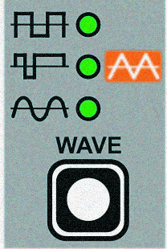
AC wave-forms
DYNAMIC
Rectangular wave
Most common
High arc stability
Small-medium thickness
COLD
Triangular Wave
Low heat transfer -- with reduced deformation
Small thickness
SOFT
Sinusoidal wave
Silent an soft arc
Butt welding joints
SPEED
Mixed Wave
Good penetration at high welding speed
Big thickness
Longer electrode life
Overview
Rectangular DYNAMIC TIG … for all applications
Triangular COLD TIG … for small thickness
Sinusoidal SOFT TIG … for low noise
Mix wave-form SPEED TIG … for high speed / long electrode-life

Slide 6
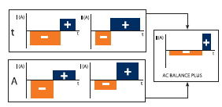
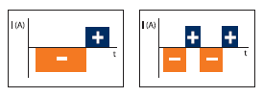
Balance / Frequency
Balance
Positive and negative wave – separatly adjustable
Pos / Neg – power
Pos / Neg – time
Proportion of Pos / Neg wave
AC Frequency
High frequence => very thin sheets, high welding-speeds (automatic use)

Slide 7
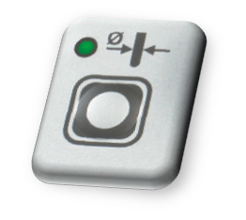
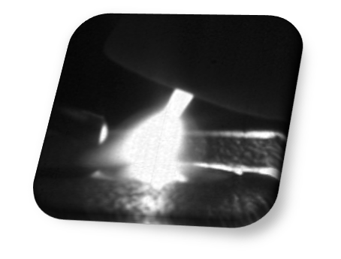
Tungston-Electr. Diameter
Elektrode-diameter adjustable
Iginition-Courrent adjusted
Shaping of ball (‚calotte‘)
MMA – also in AC possible
To avoid blowing-effect
Hotstart and Arcforce adjustable

Slide 8
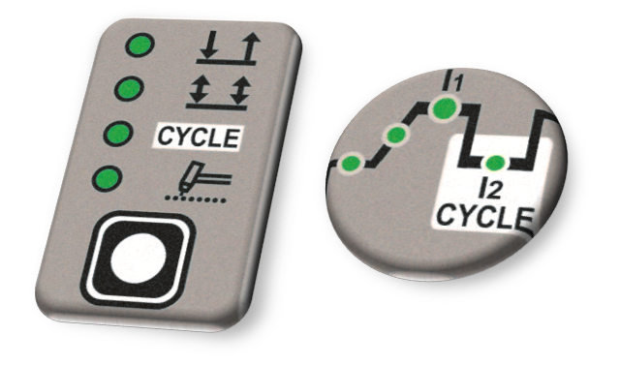
Cycle-function
Switching between 2 set Amp-levels – by torch-trigger

Slide 9
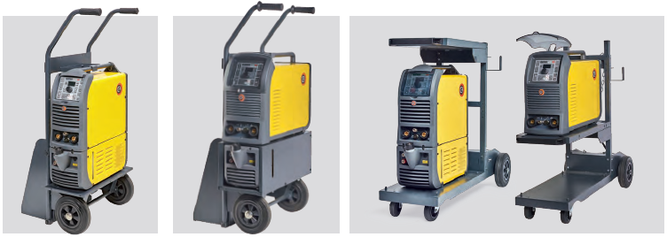
MATRIX - accessories

Slide 10
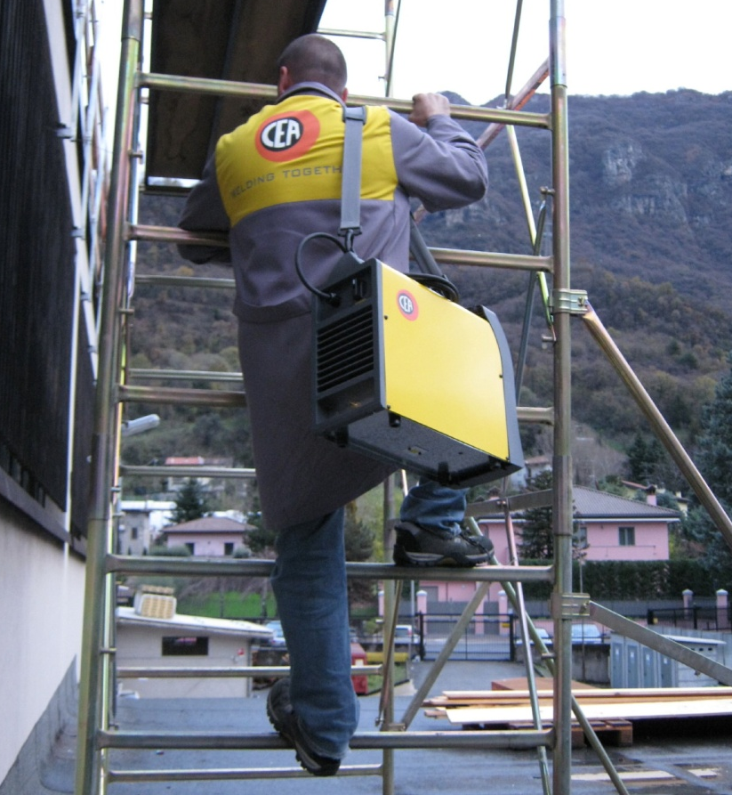
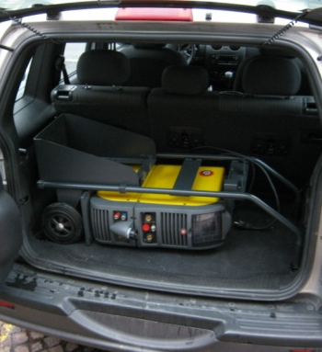
Matrix X
Very small and compact
300A version …. 17kg

Slide 11
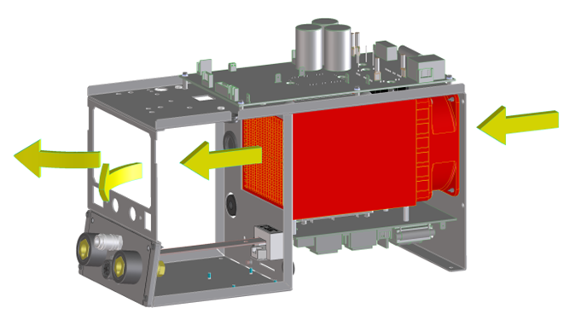
Matrix X
Modern Cooling-concept
High duty-cycle (60% - 400A/500A version)
No metalic dust on electronic components
Less maintenance

Slide 12
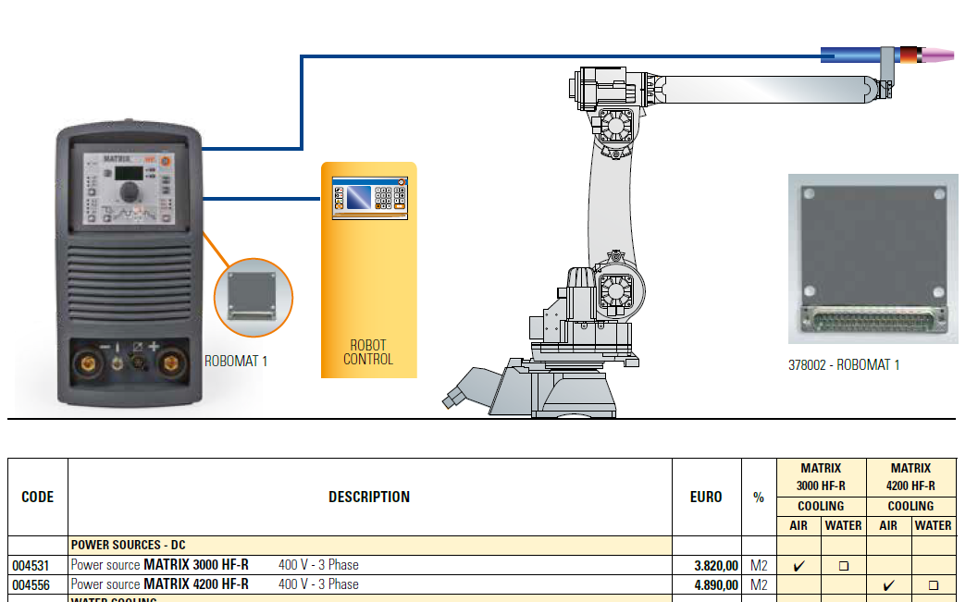
Matrix X – for robotic/automatc use
….

Slide 13
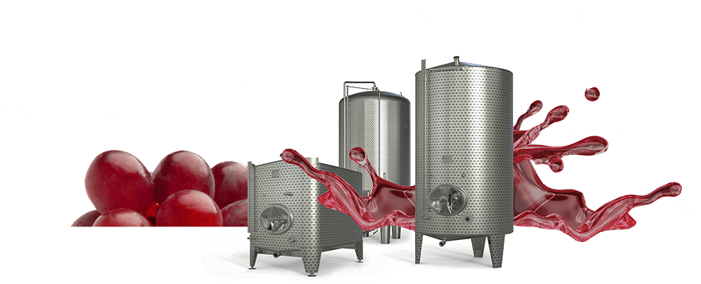
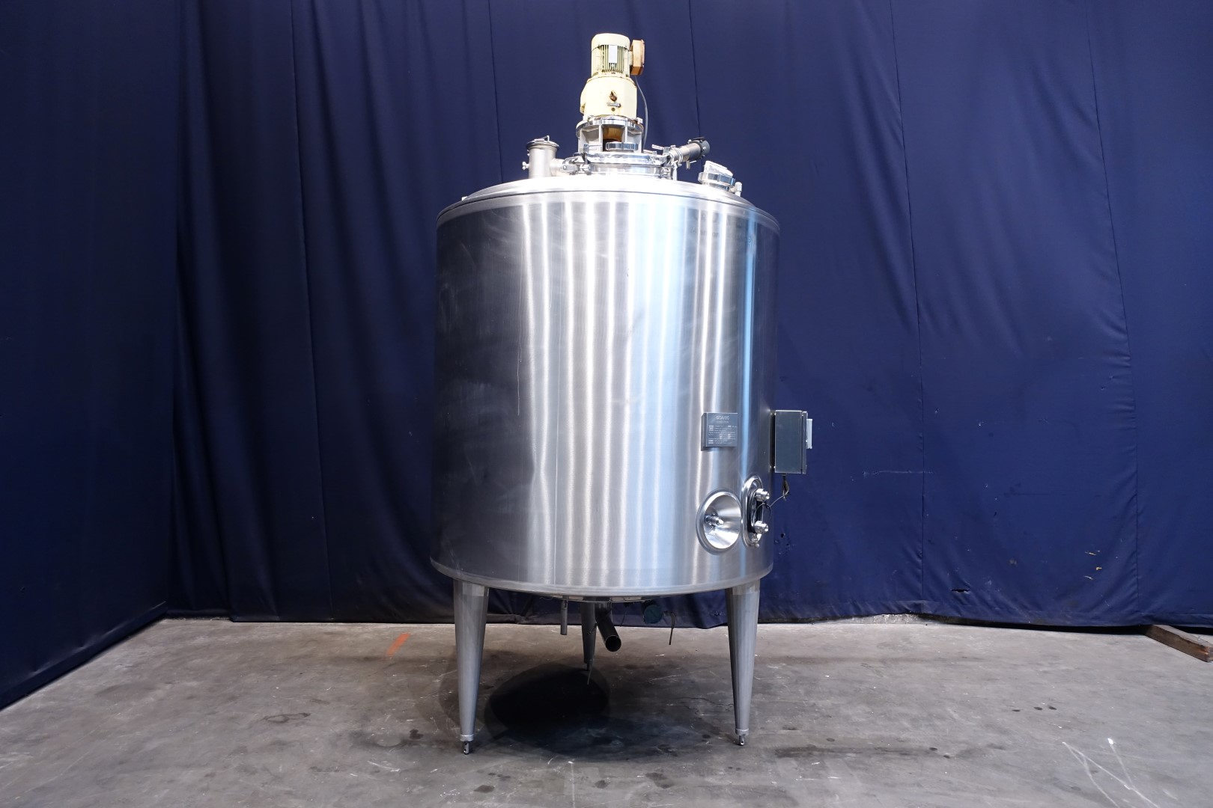
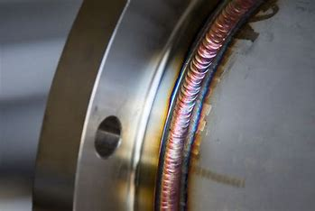
Matrix X - target-group
.

